Slide 1
Shop Map Manager
Your Personal Store Discovery & Location Tracking System

Slide 2
What is Shop Map Manager?
🗺️ A powerful web app for discovering and tracking shops/locations
🐍 Built with Python and Streamlit for easy deployment
🇨🇳 Uses Gaode (高德) Maps for China location services
☁️ Dual mode: Local (CSV) or Cloud (Supabase) storage
👤 Optional auth for cross-device sync & image uploads
🎯 Perfect for travelers, foodies, and urban explorers

Slide 3
💡 Why Use Shop Map Manager?
Never Forget
Personal Journal
Keep track of interesting places you want to visit
Build your personal map of experiences
Smart Discovery
Visual Planning
Find new spots through intelligent search
Plan visits with interactive map visualization

Slide 4
🚀 Key Features
👤 Authentication
☁️ Cloud Sync
📍 Interactive Map
Sign up/Login with email via Supabase
Sync data across devices with Supabase
Display shops on Gaode map tiles
🔍 Smart Search
📸 Image Upload
✅ Visit Tracking
Search via Gaode Map API
Upload & manage shop photos
Track visited vs want-to-visit

Slide 5
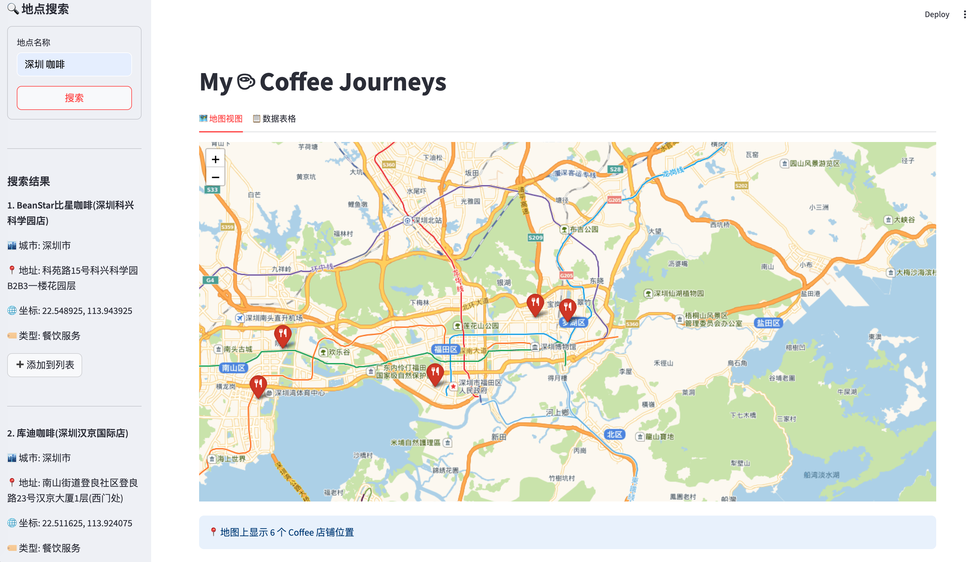
🗺️ Interactive Map View

Slide 6
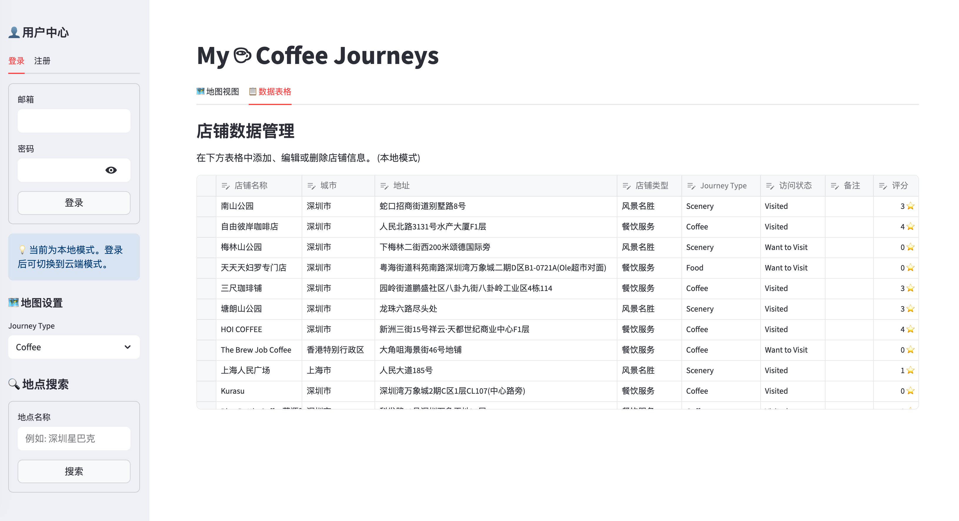
📋 Data Table View

Slide 7
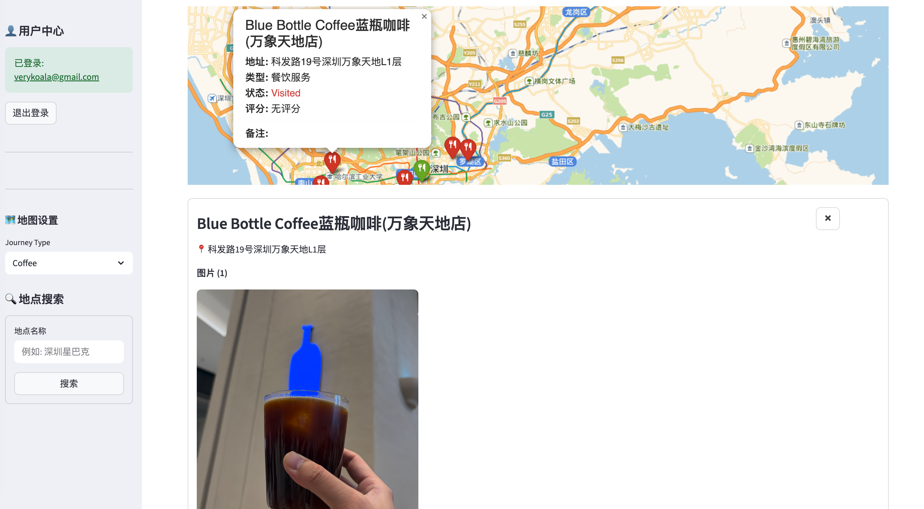
☕ Shop image

Slide 8
🔄 How It Works
🔐 Choose mode: Local (no signup) or Cloud (login required)
🔍 Search shops by name via Gaode API sidebar
➕ Click 'Add to List' to save search results instantly
✏️ Edit shop details in the data table view
📸 Upload photos to shops (cloud mode only)
🗺️ View & track locations on interactive map

Slide 9
⚙️ Technology Stack
Frontend & UI
Backend & Data
• Python 3.x - Core language
• Streamlit - Modern web framework
• Folium - Interactive map visualization
• Streamlit-Folium - Seamless integration
• Custom HTML/CSS - Popup styling
• Pandas - Powerful data manipulation
• Supabase - Authentication & Database
• Supabase Storage - Image hosting
• CSV - Local data storage option
• Gaode Map API - Location search
• Requests - HTTP API client

Slide 10
🏗️ Architecture & Design
📁 Modular: app.py (main) + map_utils.py (API & storage)
💾 Dual storage: Local CSV or Supabase cloud
🔐 Optional auth via Supabase (Email/Password)
☁️ Auto cloud sync when logged in
📸 Image storage via Supabase Storage
🗺️ Gaode tiles for Chinese maps
🎨 Color-coded: Red (Visited) / Green (Want to Visit)

Slide 11
📊 Data Structure
Core Information
User Tracking Fields
• User ID (cloud mode)
• Shop Name (required)
• City location
• Full address
• Latitude & Longitude
• Shop Type/Category
• Journey Type (Coffee/Scenery/etc)
• Visit Status dropdown
• Rating (1-5 stars)
• Notes (free-form text)
• Image URLs (JSON array)

Slide 12
🚀 Getting Started

Slide 13
Installation & Setup
📦 Install: pip install -r requirements.txt
🔑 Create .env file with API keys (see .env.example)
🔑 Required: GAODE_API_KEY, SUPABASE_URL, SUPABASE_KEY
▶️ Run: streamlit run app.py
🌐 Open browser to: http://localhost:8501
✨ Start searching for places!

Slide 14
🔮 Future Enhancements
📱 Enhanced mobile-responsive design for on-the-go access
🔔 Smart visit reminders and notifications
🗺️ Route planning between multiple shops
📊 Statistics dashboard with insights
👥 Social sharing of favorite places
🤖 AI-powered recommendations based on preferences

Slide 15
Thank You! 🎉
Shop Map Manager - Your Personal Location Journal

